Slide 1
Future Floating Mission
Topic
For bigger spacecraft capable of executing bigger missions, some of the assembly may be done in space. Our challenge is to design a simple approach that enables components to be assembled in space.

Slide 2
Approach
Our Approach to assembling in Space deals with Creating a Space corridor for fundamental assembling in LEO or any specified orbit.
The Space corridor is not in conventional sense a corridor for Space but rather it's a low resistance near vacuum path that needs to be trailed by a secondary rocket in its journey toward the first 100 kms.
The exceeding rocket due to its high velocity creates a low pressure zone that is trailed by the secondary rocket processing in the exhaust of the the first rocket as a exhaust breathing engine with ram compression in effect.
The proximity sensor mounted on both rockets monitors the minimal distance that is required to maintain a safe, no collision scenario.
This is employed with a feedback loop in order to continuously monitor the distance and performance of the secondary rocket relative to the primary rocket.
Once they are in orbit, phasing maneuver with ORM is carried out for rendezvous point with specified attitude control in order for docking mechanism to be executed.

Slide 3
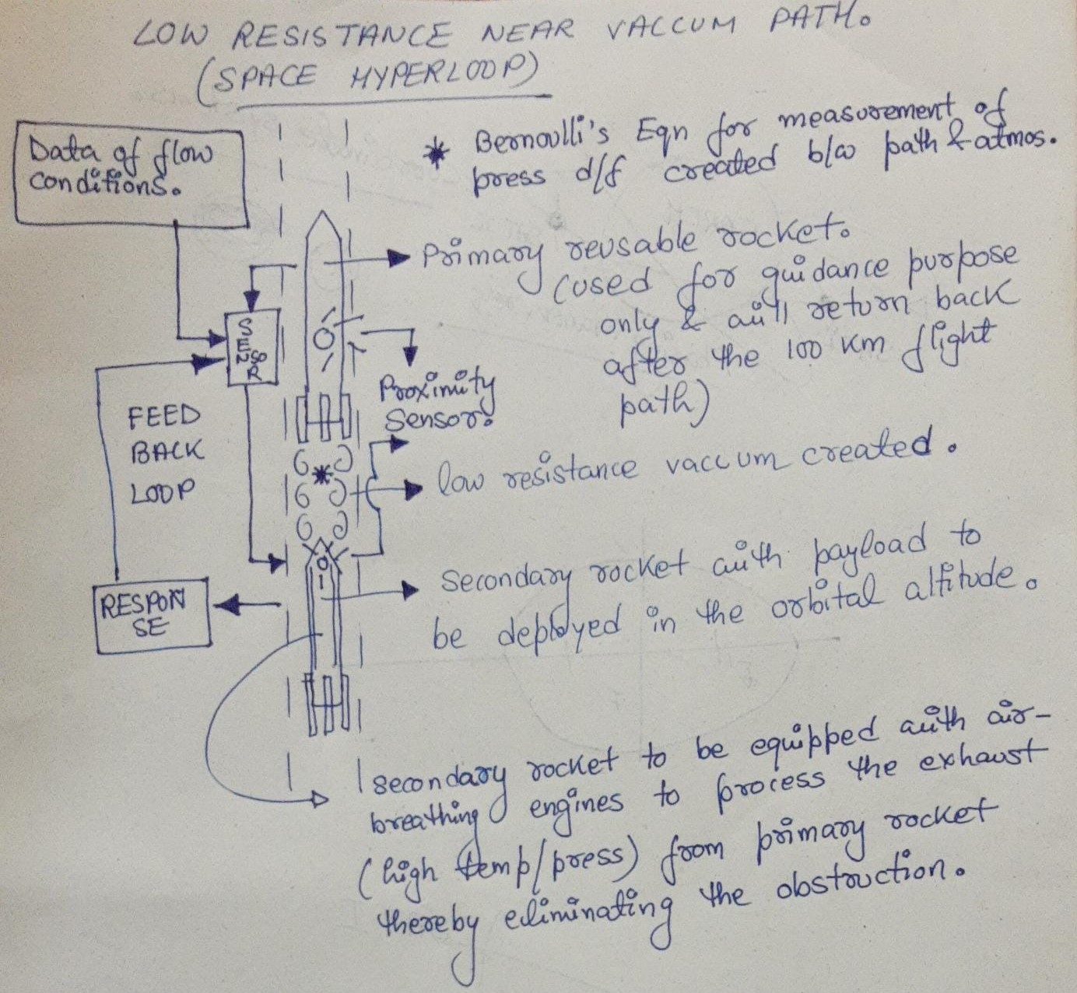
Low Resistance near vacuum path

Slide 4
Feedback Control General Outline
The sensors from the rocket 1 (R1) will calculate and relay the data like distance, altitude etc. as an output signal to the trailing rocket (R2) , which will follow the output signal from R1 , which becomes the input signal for R2, and actuate the sensors like proximity sensors according to the feedback to maintain the proximity, critical distance and track via feedback control method

Slide 5
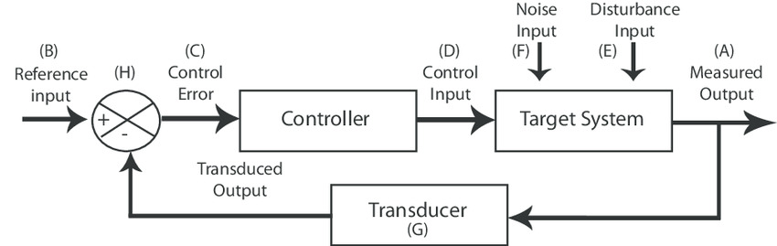
Feedback Control General Outline Diagram

